Slide 1
Cipher App
By steven A smith

Slide 2
OUTLINE
The problem we are solving
Why was this chosen?
Application design
Languages chosen and reason why
Obstacles that came up
How I got past them
Demo time
Future renditions and fixes

Slide 3
The Chosen Topic
CIPHERS

Slide 4

Why Ciphers?
I chose ciphers for the sole reason being that I think it is an interesting topic of study.
After taking an encoding and encryption course, I wanted to learn a bit more about some cryptography history and its uses.
This led me to creating a small web application based on solving ciphers given in a list format.

Slide 5
Application Design
A few application designs were put to thought when creating this application:
  Built to work
  Give users something to learn from
  Prevent user errors
  Uniformity for use

Slide 6
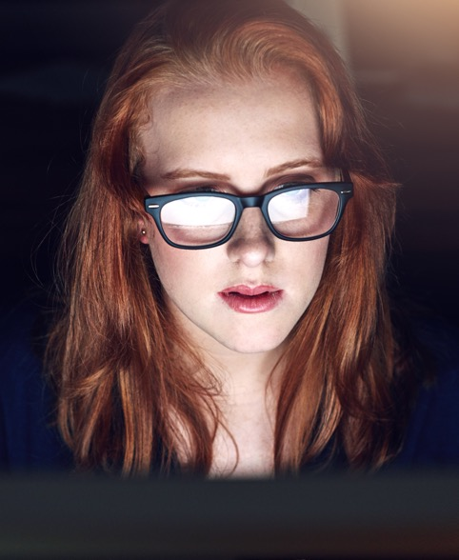
Languages Used
JavaScript (React)
HTML
CSS

Slide 7
Why these languages?
JS | JS | JS
HTML | HTML | HTML
CSS | CSS | CSS
I chose to incorporate these three languages together, that I have very little experience with, using an open-source, front-end library called “React”.
React is used primarily for building user interfaces or user interface components.
The reason why I chose this was due to its dynamic nature when it comes to implementing components and JavaScript.

Slide 8
Obstacles that came up
There were a few roadblocks that popped up as I progressed through the project:
Lack of experience with JS, HTML, and CSS
Routing and using navigation with React
Answer validation with maps
Consistency issues
Formatting trouble

Slide 9
How I beat those obstacles
Time and the internet (YouTube) were my friends here:
More time with the languages gave me enough experience to truck ahead.
  Research helped on that as well, especially the CSS styling parts.
Find Obstacle
Research and Tackle it
Profit

Slide 10
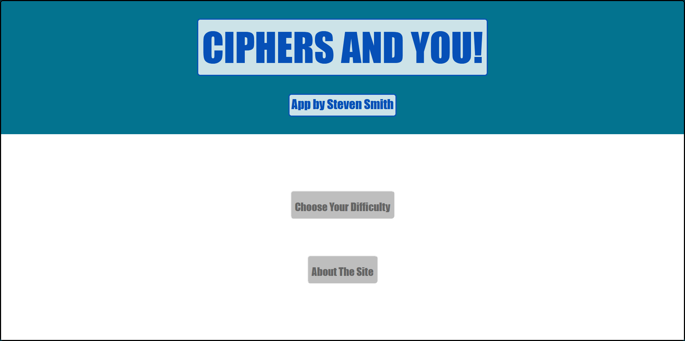
Demo time

Slide 11
Future Renditions and fixes
Styling Needs to change
Larger and more Random Ciphers
If there was one thing I would want to make some major improvements on, it would be the CSS styling.
Modern-izing the web application would make it look so clean and crisp to the eyes. My lack of experience created an out-of-date web page with inconsistent colors and buttons.
Another item on the list would be more ciphers, quite literally. I originally planned on a site that would randomly pick a cipher from a list that is mapped to the answer and render it in on a new page.
That did not go as planned. Instead, I just iterated the list onto each level’s page with textboxes and answer buttons.

Slide 12

Questions?

Slide 13
Works Cited
“React – A JavaScript Library for Building User Interfaces.” React, reactjs.org.
Rodriguez-Clark, Daniel. “Crypto Corner.” Https://Crypto.Interactive-Maths.Com/, Interactive Maths, 2013, crypto.interactive-maths.com.

Slide 14
Contact ME
GITHUB
HTTPS://GITHUB.COM/SEIYANBRUH
Email
sasmith10@student.ysu.edu

